Slide 1
第8-3章：Network Module
Definition
Module detection
Bayesian approach
Markov clustering algorithm

Slide 2
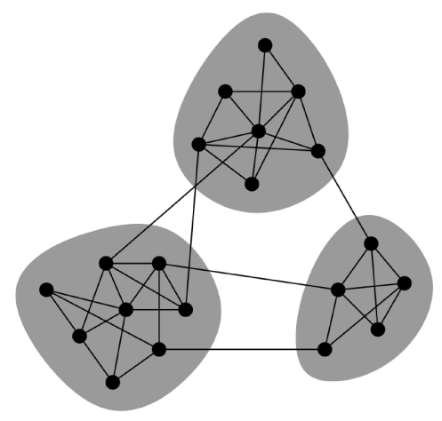
Network Modular

Slide 3
Modularity
Suppose we are given a candidate division of the vertices into some number of groups. The modularity of this division is defined to be the fraction of the edges that fall within the given groups minus the expected such fraction if edges were distributed at random.
http://en.wikipedia.org/wiki/Modularity_(networks)

Slide 4
Modularity
A_{ij}: adjacency matrix
k_{i}: degree
m: total number of edges

Slide 5
Modularity
For two class problem, let s_{i}=1 of node I belongs to group1 and s_{i}=-1 if it belongs to group 2,

Slide 6
Example
1
2
3
4
5

Slide 7
Spectrum Method
The largest eigenvectors will gives the best grouping, positive entries corresponding to one class, and negative ones corresponding to another class.
This can be achieved by power method
where e=(1,1,…,1)^{T}

Slide 8
Example
对于上述矩阵B, 可以计算出最大特征值为10, 对应的特征向量
于是我们对节点的划分为{1,2}; {3,4,5}
1
2
3
4
5

Slide 9
优化方法
既然现在有一个衡量划分“好坏”的量Q, 那么一般的优化方法都可以使用;
1. 给定初始划分
2. 对于划分的某种修正, 计算Q的改变量
3. 依据一定的原则考虑是否接受这种修正，重复步骤2, 直到某种收敛条件满足。
Greedy方法
模拟退火方法

Slide 10
A Bayesian Approach to Network Modularity
Slides for this part are mainly from Hofman’s talk
www.jakehofman.com/talks/apam_20071019.pdf

Slide 11
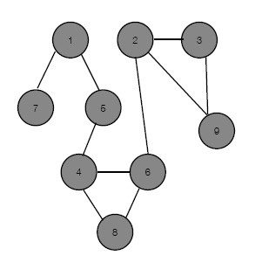
Overview: Modular Networks
Given a network
Assign nodes to modules?
Determine number of modules(scale/complexity)?

Slide 12
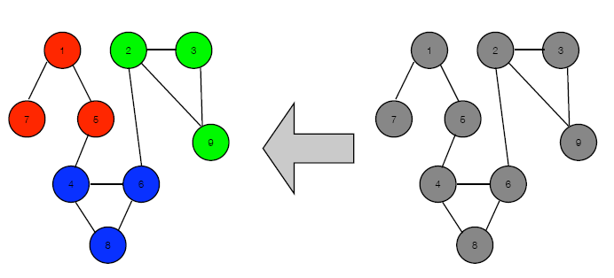
Overview: Modular Networks
With a generative model of modular networks, rules of probability tell us how to calculate model parameters (e.g. number of modules & assignments)

Slide 13
Generative Models
Generate Synthetic data
Observed real data
Known model
(parameters, assignment variables, complexity)
Inferred Model
(parameters, latent variables, complexity)

Slide 14
Generating Modular Networks
For each node:
Roll K-sided die to determine z_{i}=1,...,K, the (unobserved) module assignment for ith node
For each pair of nodes (i,j):
• If z_{i}=z_{j}, flip “in community” coin with bias θ_{c} to determine edge
• If z_{i}≠z_{j}, flip “between communities” coin with bias θ_{d} to determine edge

Slide 15
Generating Modular Networks
Die rolling, coin flipping, and priors:

Slide 16
Generating Modular Networks
Edges within modules
Non-edges within modules
Edges between modules
Non-edges between modules
Nodes in each modules

Slide 17

Inferring Modular Networks
From observed graph structure, infer distributions over module assignments, model parameters, and model complexity

Slide 18
Approximate Inference for Modular Networks
Jensen’s inequality (log of expected value bounds expected value of log) for any distribution q

Slide 19
Approximate Inference for Modular Networks
F is a functional of q; find approximation to posterior by optimizing approximation to evidence
Take q(z, π, θ)=q(z)q(π)q(θ); Q_{iμ} is probability of node i in module μ

Slide 20
Variational Bayesian

Slide 21
Variational Bayesian
Where the expected counts

Slide 22
Variational Bayesian Method
问题：
给定数据D, 缺失数据Z={Z₁, Z₂,…,Z_{k}}, 极大化后验概率分布 ,目标函数复杂，很难得到Close form.
策略
寻找一个合适的近似分布Q(Z)

Slide 23
如何近似
解决两个问题
如何度量Q(Z)和P(Z | D)的差异
Kullback-Leibler Divergence
如何得到简单的分布Q(Z)
可分解分布(Factorized Approximation)

Slide 24
Kullback-Leibler Divergence
具有如下三个性质
不对称性：
非负性： 当且仅当p=q时为0’
不满足三角不等式

Slide 25
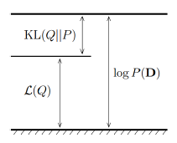
优化基础
故令
则

Slide 26
优化基础
另一方面
这里 log P(Z,D)在物理上称之为能量，而后者是Q的熵

Slide 27
平均场(Mean Field)近似
采用可分解分布进行近似

Slide 28
平均场近似下的优化算法
优化问题
约束条件

Slide 29
优化问题求解
可以证明，上述优化问题的解：
其中 C为归一化因子. 表示除了Z_{i}之外的其它隐变量。

Slide 30
优化公式推导
考虑Z=(Z_{i}, Z_{[-i]})

Slide 31
优化公式推导
定义 其中C为Q*的归一化因子. Q*定义了一个Z_{i}上的新的概率分布
另一方面

Slide 32
优化公式推导
于是
上式作为Q_{i}的泛函，由变分原理得

Slide 33
优化公式推导
实际上，直接由KL散度的非负性，只有当散度为0时，L(Q)取最大值，即

Slide 34
变分原理
泛函：以函数为自变量的函数
泛函J(y)在y=y(x)极大值：对于y的任何一个扰动δy
从形式上看，和y是普通变量的含义类似。

Slide 35
变分原理
极大值的必要条件：一级变分为0
带约束J₀(y)极大值的必要条件(Lagrange乘子)
从形式上看，和y是普通变量的含义类似。

Slide 36

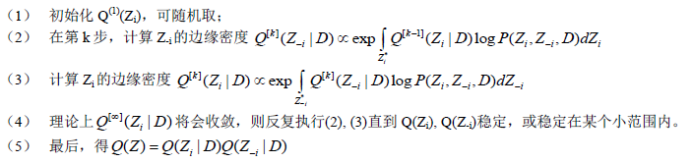
迭代算法

Slide 37
Markov Clustering Algorithm
van Dongen. A cluster algorithm for graphs. Information Systems, 2000

Slide 38
K-length Path
Basic idea: dense regions in sparse graphs corresponding with regions in which the number of k-length path is relatively large.
Random walks can also be used to detect clusters in graphs, the idea is that the more closed is a subgraph, the largest the time a random walker need to escape from it.

Slide 39
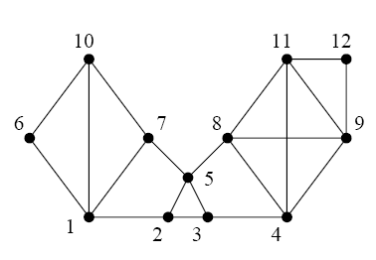
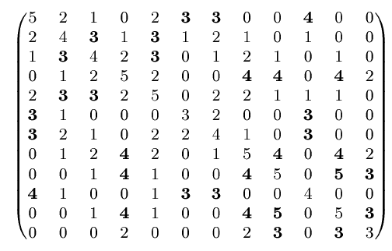
K-path Clustering
Matrix manipulation: (N+I)²

Slide 40
Markov Clustering
Expansion: Through matrix manipulation (power), one obtains a matrix for a n-steps connection.
Inflation: Enhance intercluster passages by raising the elements to a certain power and then normalize

Slide 41
Markov Clustering Algorithm
Iteratively running two operators
Inflation:
Expansion:
Column normalization

Slide 42
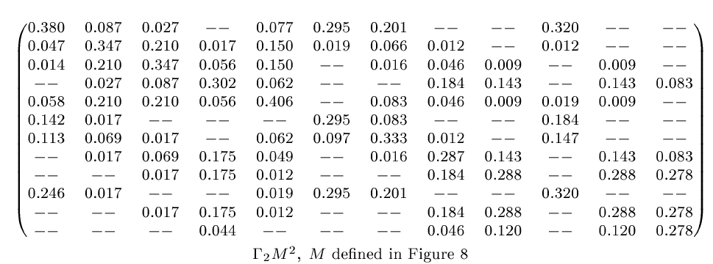
MCL Running

Slide 43
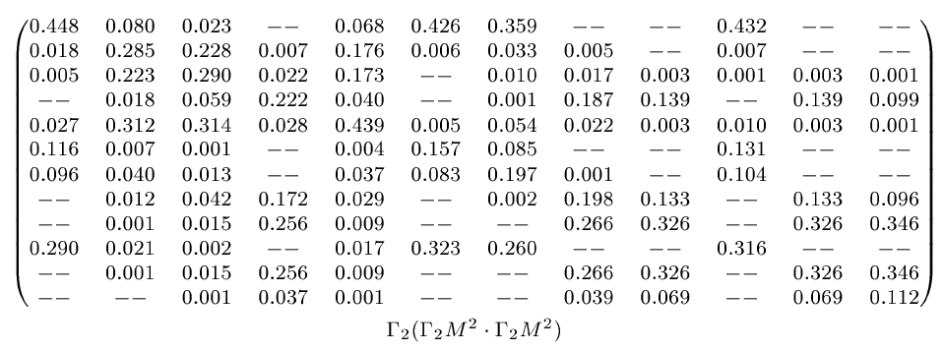
MCL Running

Slide 44
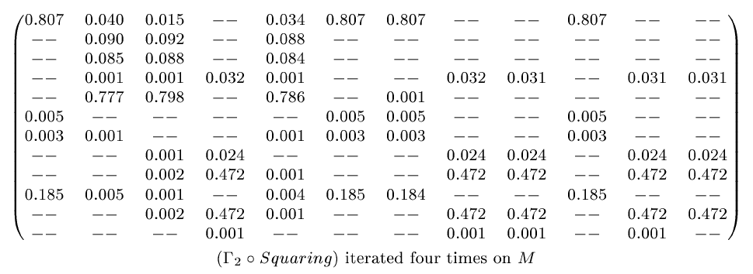
MCL Running

Slide 45
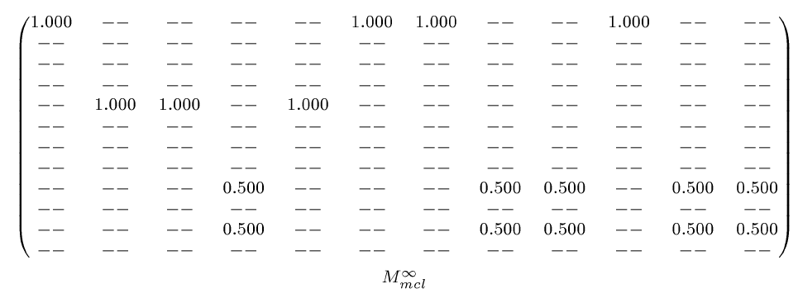
MCL Running

Slide 46
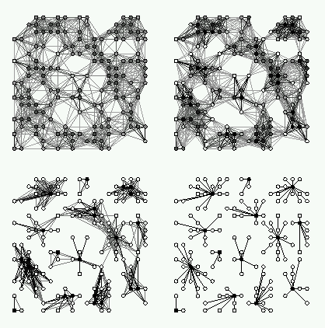
A Heuristic for MCL
We take a random walk on the graph described by the similarity matrix
After each step we weaken the links between distant nodes and strengthen the links between nearby nodes
Graphic from van Dongen, 2000

Slide 47
我们的一个扩展
Diffusion kernel可以定义网络上的节点之间的Global影响。
而MCL算法将在同一个模块内的关联加强，而将不同模块之间的联系减弱。
如何将两者融合起来？
Naifang Su, Lin Wang, Yufu Wang, Minping Qian and Minghua Deng. Prediction of Protein Functions from Protein-Protein Interaction Data Based on a New Measure of Network Betweenness. Proceeding of iCBBE 2010.

Slide 48
我们的一个扩展
定义矩阵
其中
最后的相似矩阵B: 对角上为0, 对K做列归一化矩阵

Slide 49
参数的选取
实际应用中，我们尝试选取
在我们的交叉验证中, 得到了最大的AUC.

Slide 50
References
Newman MEJ, Modularity and community structure in network. PNAS 103: 8577-8582, 2006.
Hofman, JM and Wiggins, CH. Bayesian approach to network modularity. Physical Review Letters 100:258701, 2008.
S. van Dongen. A cluster algorithm for graphs. CWI Report INS-R0010, 2000.
侯琳, 邓明华. 网络聚类算法及其生物信息学应用. 数学建模及其生物信息学应用. Vol.2(2): 9-14, 2013.
CharlesW. Fox, Stephen J. Roberts. A tutorial on variational Bayesian inference. Artif Intell Rev (2012) 38:85–95.DOI 10.1007/s10462-011-9236-8
C. M. Bishop. Pattern Recognition and Machine Learning. Springer. 2006. (第10章：变分近似)

